Slide 1

CVS Ecosystem
By Ctrl Alt Decode
BO LIU
TIANYU WEI
KAUSHIK PATIL

Slide 2

Problem Statement
Nowadays, CVS and its management system is under low efficient.
User need to come to the retail stores for purchasing instead of seating at home with items coming through delivary.
Every enterprise in the ecosystem is sending orders by phone or even paper which causes resourses wasting and uneffiency.

Slide 3

Solution
Build an application to link CVS retail stores, Supplier and Delivery in a chain.
Sending order requests online for time saving and environmental friendly.
Set panel for every user like customers, supplier and delivery sending organization for enficently working.

Slide 4

Approach
CVS is able to place order for cargoes from supplier in the online Eco-system.
Use DB4OUtil integrated plugin database for data storage.
Placing order to the next node in the Eco-system by sending request information and rendering on the panel of the target user.

Slide 5
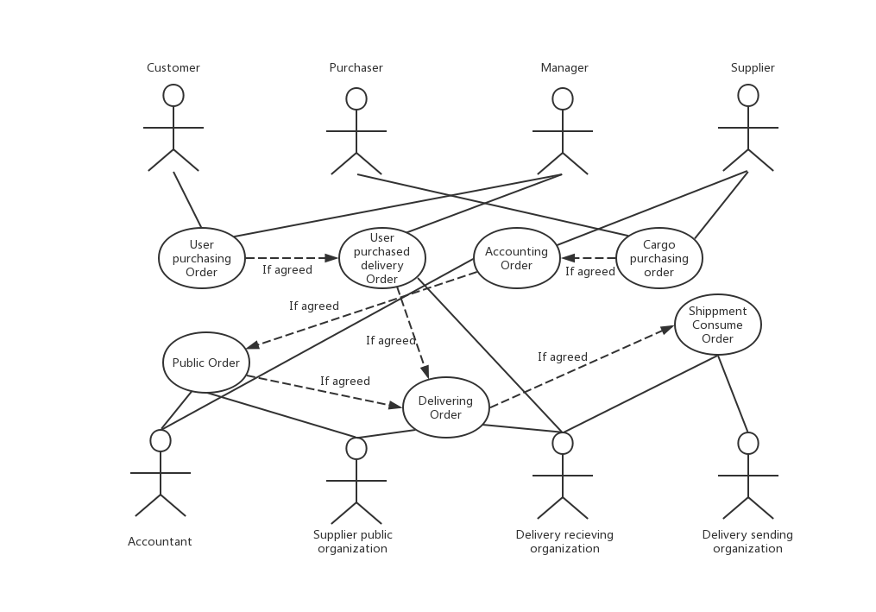
Use Case

Slide 6
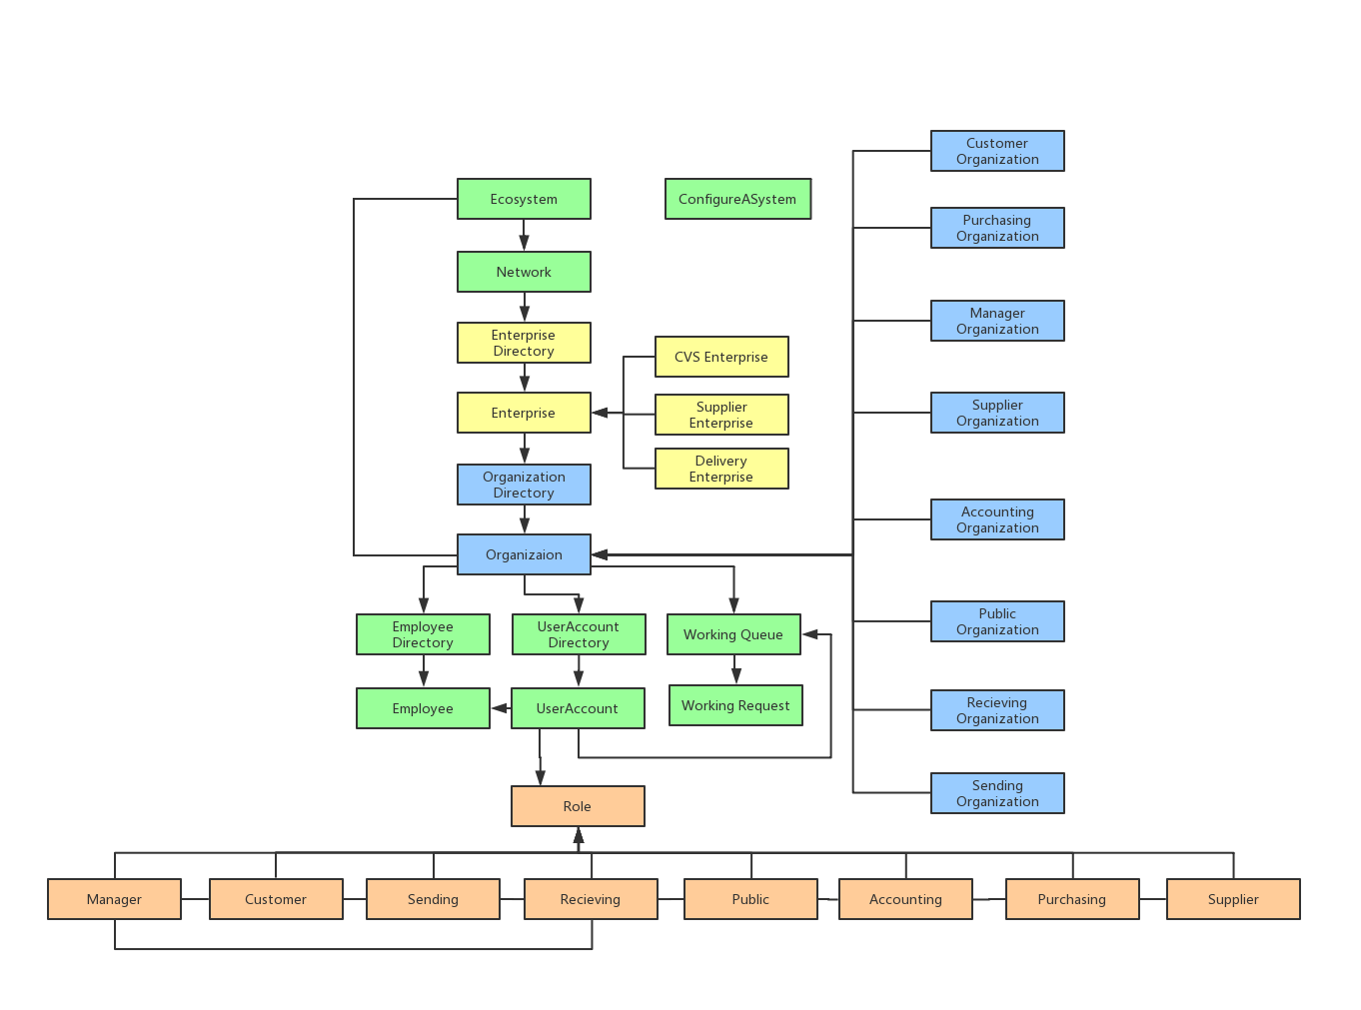
Object Model

Slide 7
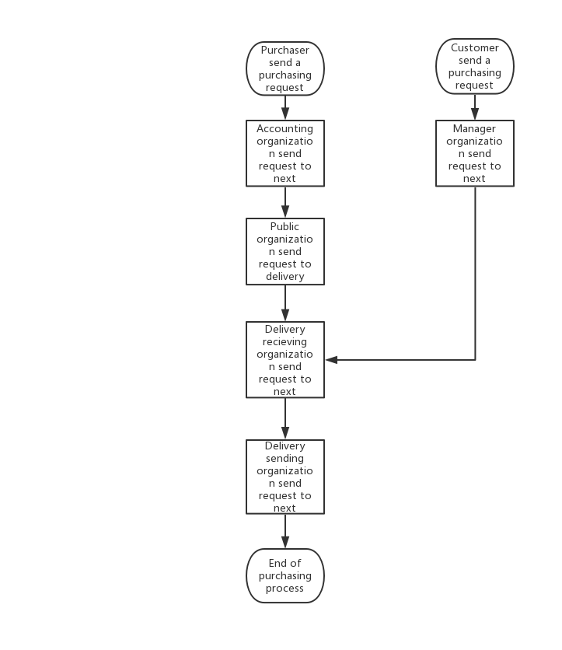
Work Flow

Slide 8
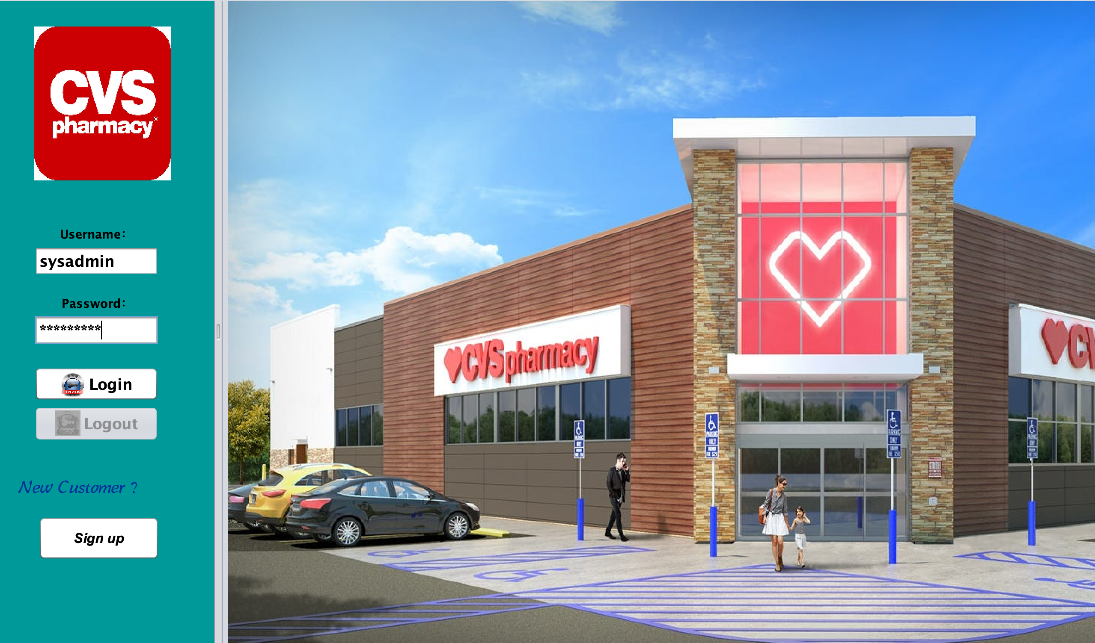
Key Screenshot

Slide 9
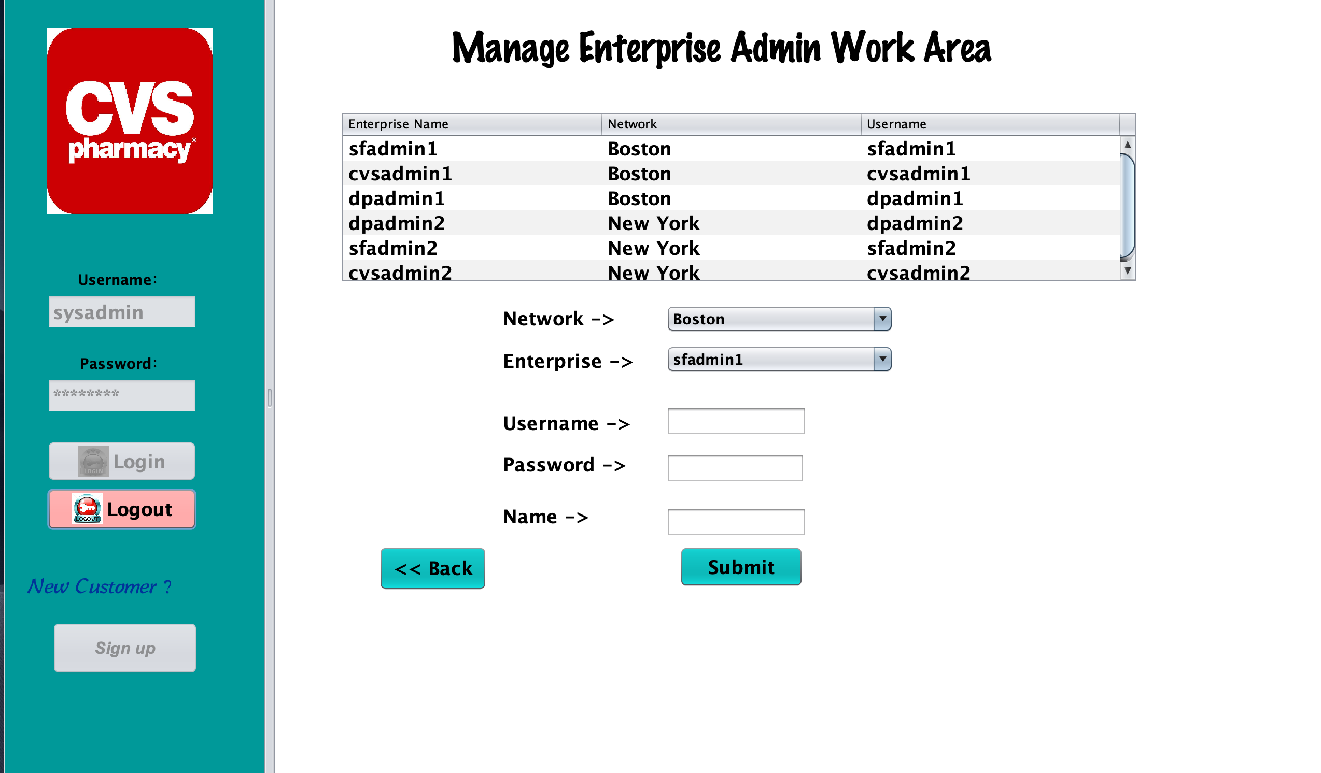
Key Screenshot

Slide 10
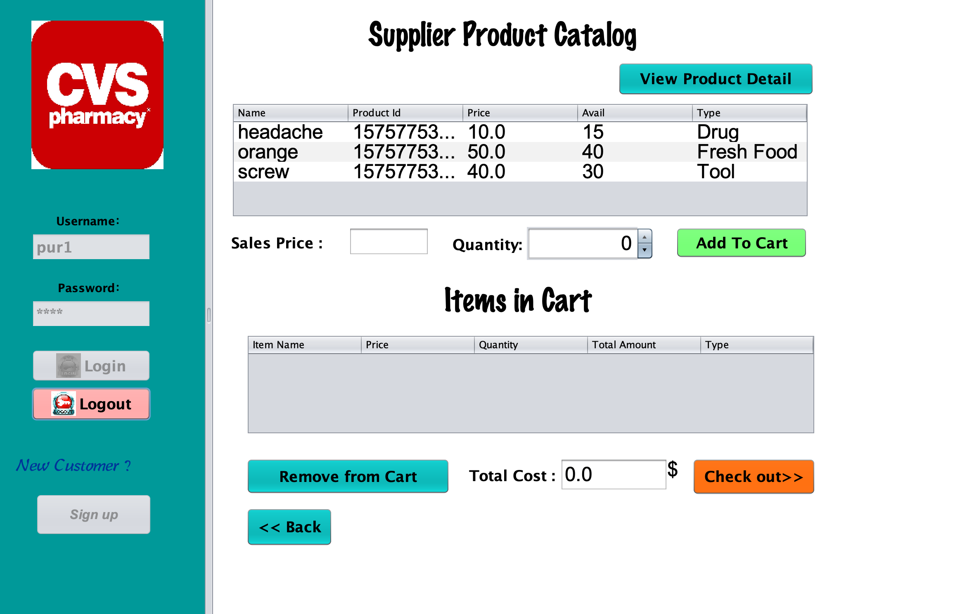
Key Screenshot

Slide 11
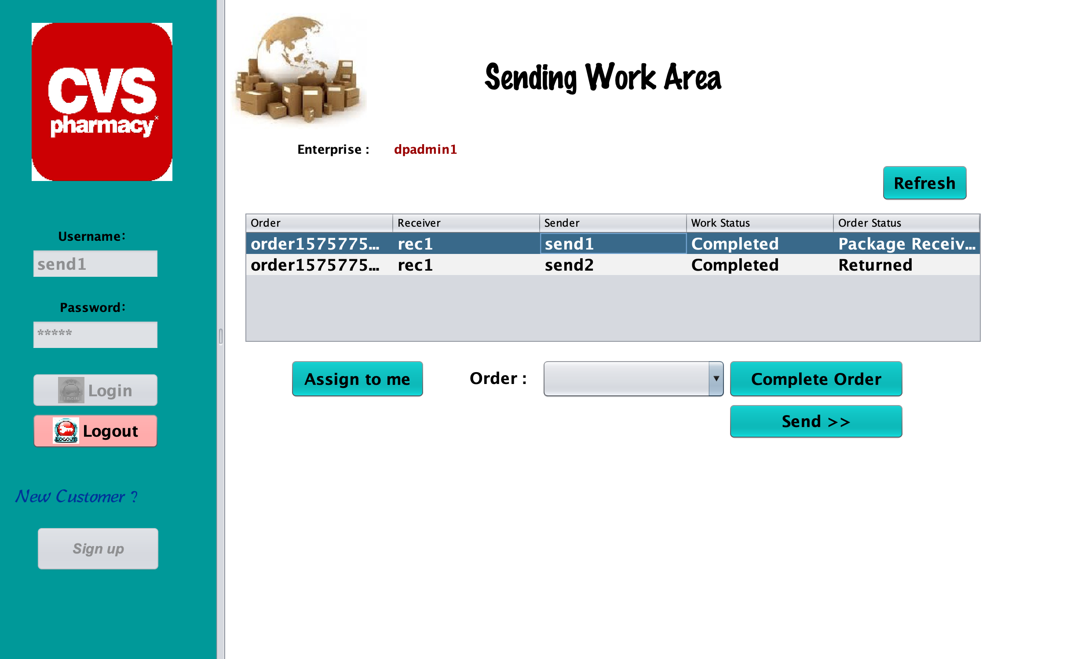
Key Screenshot

Slide 12
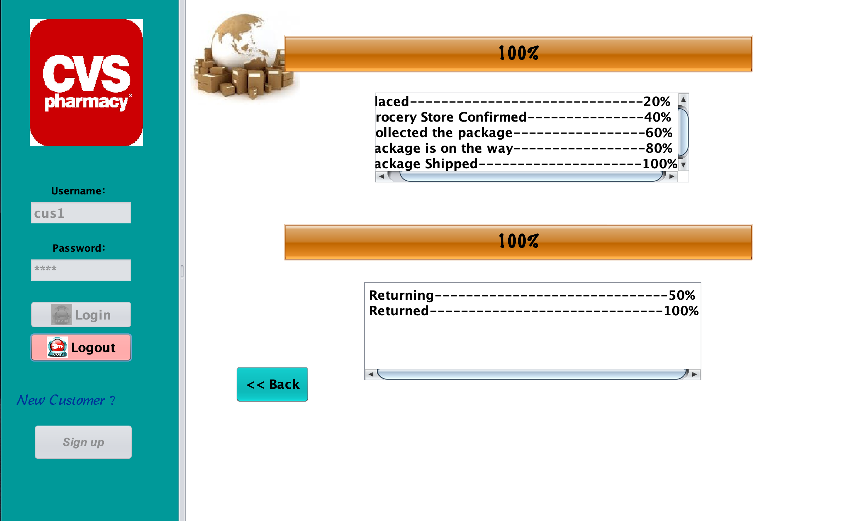
Key Screenshot

Slide 13
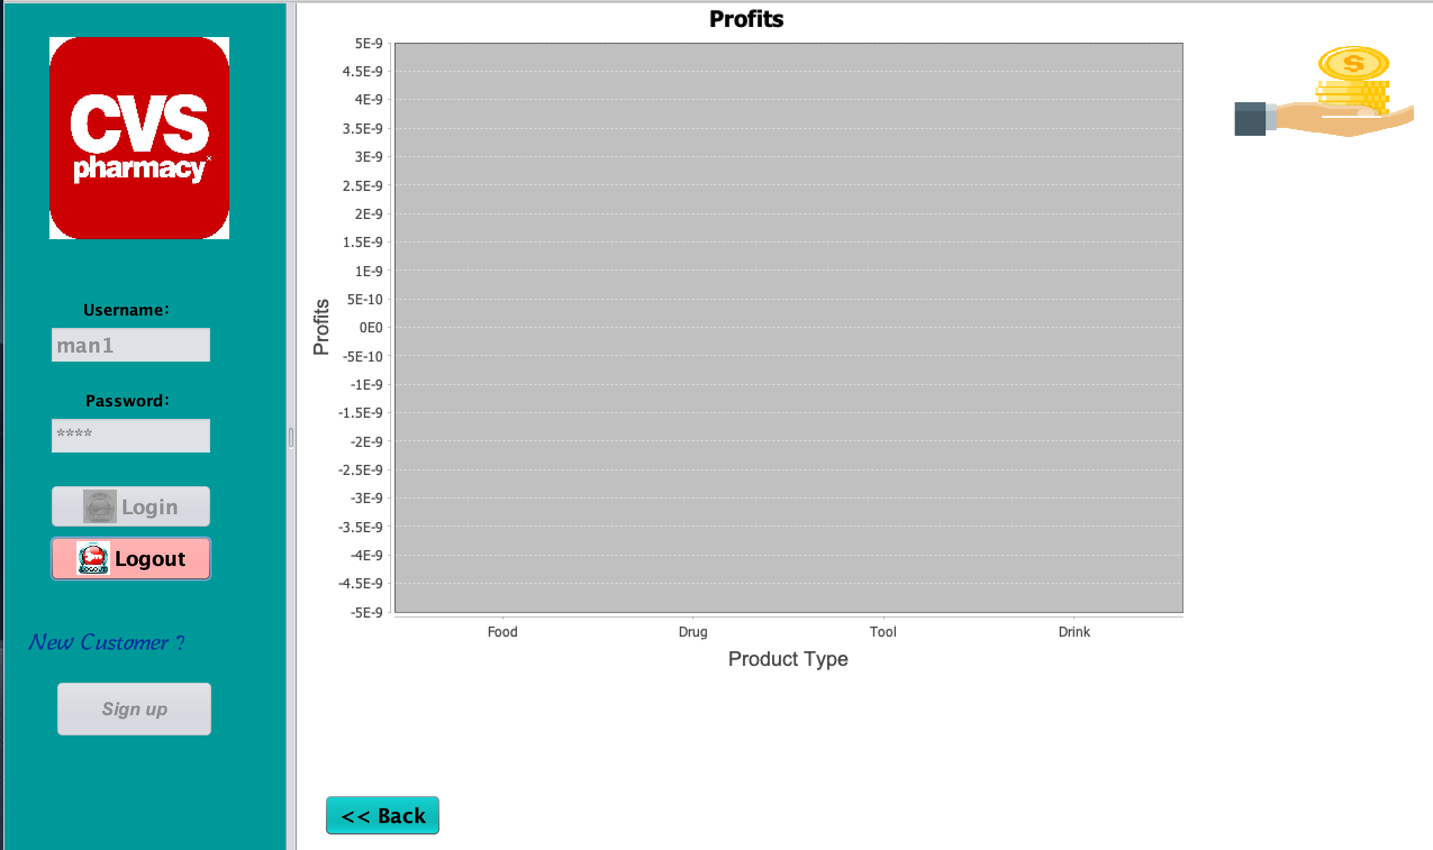
Key Screenshot

Slide 14
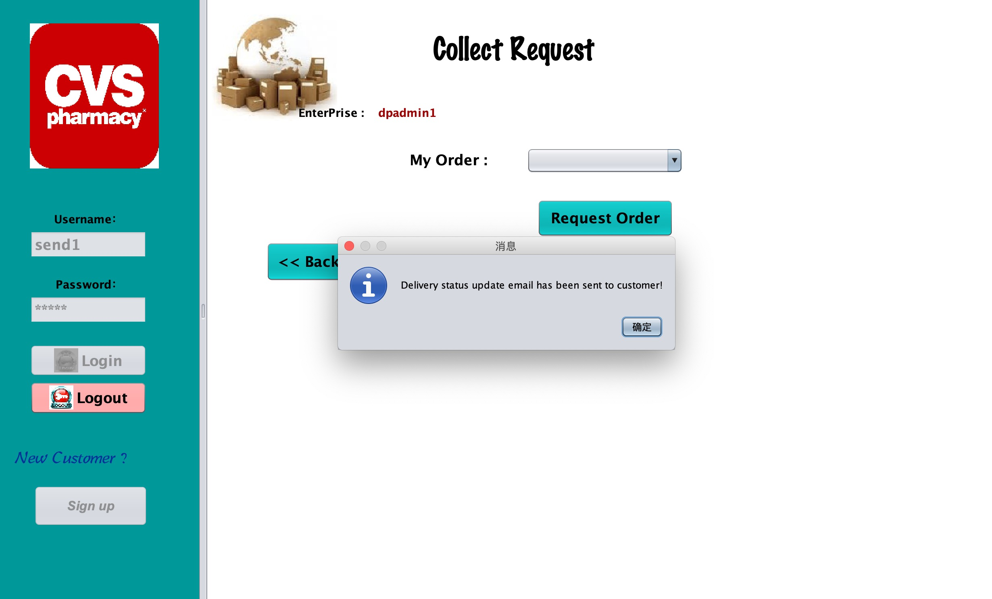
Key Screenshot

Slide 15
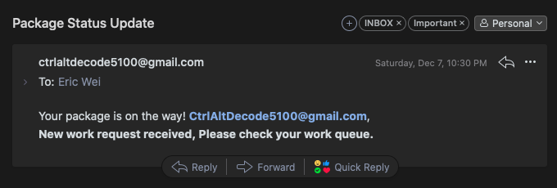
Key Screenshot

Slide 16

Thank You

